Slide 1

Linux Binary exploitation
a somewhat modern introduction

Slide 2
What to expect?
This is an introduction to modern 64-bit exploitation on Linux, with all strings attached
Being an introduction, there is emphasis on the fundamentals
BinExp is practice-heavy – this is a hands-on class
After this class you should feel comfortable with low-level stuff and debugger enough to be able to continue your own adventure without extra headaches. However,
you WILL need to practice to git gud ;]

Slide 3
What we are NOT going to cover?
Windows exploitation and its’ quirks
Network exploitation
Reverse engineering*
Heap abuse
Race conditions, JOPs, COPs
Linux-specific quirks (environmental variables, GOT overwrites etc.)
I do plan on adding some of these in the future
*there will be emphasis on understanding underlying assembly and how it translates to C, which is definitely an introduction into the topic.

Slide 4
What are we going to cover?
Assembly primer
GDB primer
Memory corruption
Stack-based exploitation
Shellcoding primer
Exploit-mitigation techniques and relevant bypasses
Stack Cookies, NX, PIE/ASLR

Slide 5
Before we begin
Do not be discouraged if you feel like you are falling behind. It takes effort and some time for us to get familiar with low-level thinking. It is going to be awkward until it just “clicks” and becomes easy :]
Slides and handout will stay shared, don’t waste time making excessive notes – you might miss on things.
ASK QUESTIONS
really, don’t be afraid. The worst that can happen is that you’ll learn something new.

Slide 6
SETUp TIME
10 minutes
Download repo, build docker image, make sure everything works correctly
Link: <link>

Slide 7
Assembly Primer

Slide 8
What assembly is NOT
Magic indecipherable language requiring forbidden knowledge to understand

Slide 9
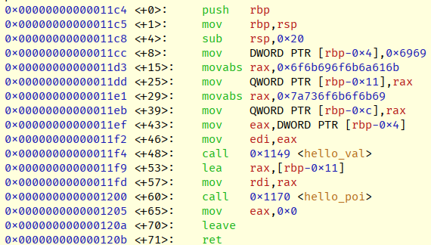
So, assembly
Is the lowest level human-understandable representation of machine code, it translates directly into instructions getting executed
Shows what is ACTUALLY being executed by the processor
There are not many abstractions here
It might feel different though
Architectural decisions (instruction set)
OS considerations
Calling conventions
Compiler optimizations
We will get to that

Slide 10
Processor
Is at the same time more and less complicated than it looks ;]
For our purposes, however, it is deceptively simple
A predictable black-box doing our bidding through small, discrete instructions
Put instruction and, optionally, some data into it
Receive result
Rinse and repeat
Von Neumann Architecture, courtesy of Wikipedia
By Kapooht - Own work, CC BY-SA 3.0, https://commons.wikimedia.org/w/index.php?curid=25789639

Slide 11
How do we interact with processor?
We specify instruction (opcode), which tells what operation should be performed
Data is passed and received through set of registers and/or memory pointers
Available instructions, data types, registers, addressing modes, and memory are all specified in ISAs (Instruction Set Architecture)
Most of the desktop world is running on AMD64 ISA, also known as x86-64, x64, Intel 64
We will be working with this one!
It is an extension of x86 ISA, which was base of most of the 32-bit systems a while ago
Other ISAs exist, most important are ARM64 and RISC-V
x64 is a painfully bloated instruction set (think, modern C++). Luckily for our purposes we do not have to nerd over most of them

Slide 12
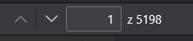
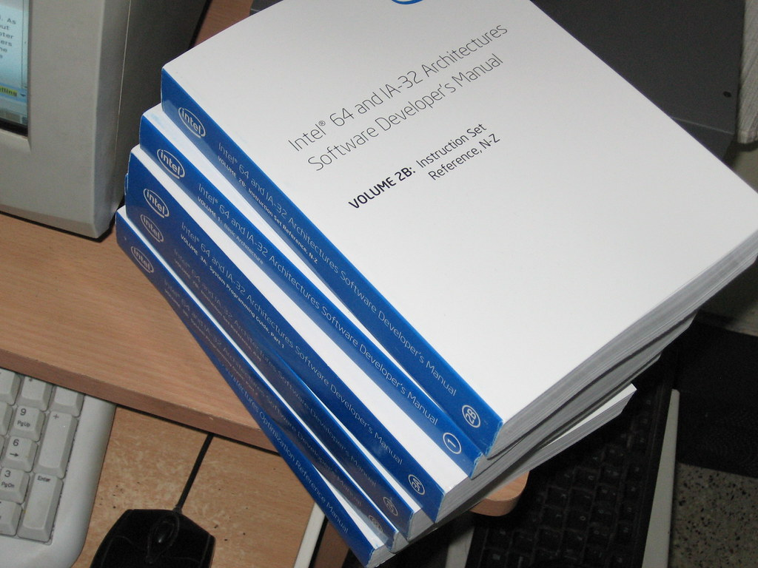
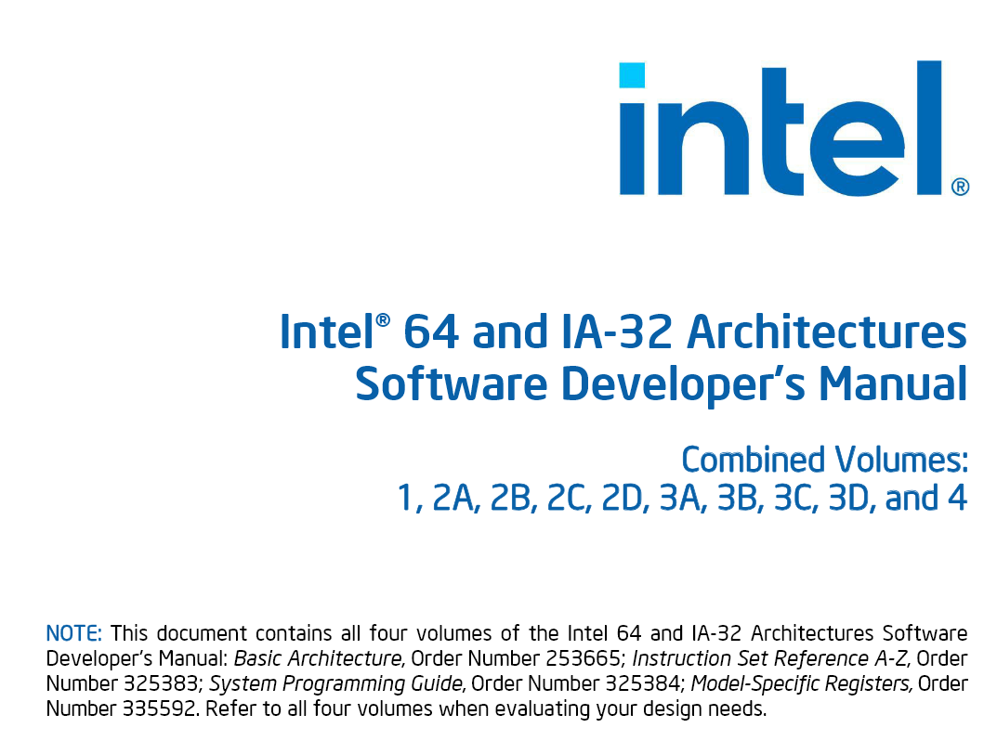
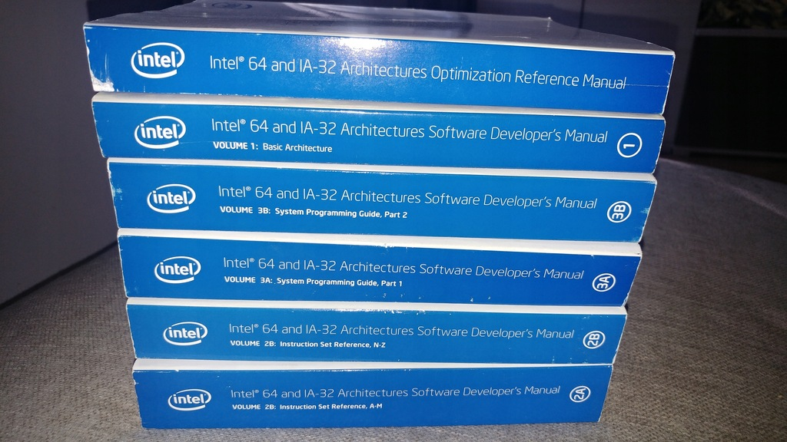
All this just to be able to use the processor, lmao

Slide 13
Everything is data!
An important distinction to keep in mind as we go through the content, there is nothing inherently different between data and code from the perspective of a processor.
The implications might not be obvious now, just consider that anything passed to the processor can be interpreted as both code to be executed and/or data to be manipulated. They are both just binary streams anyways.

Slide 14
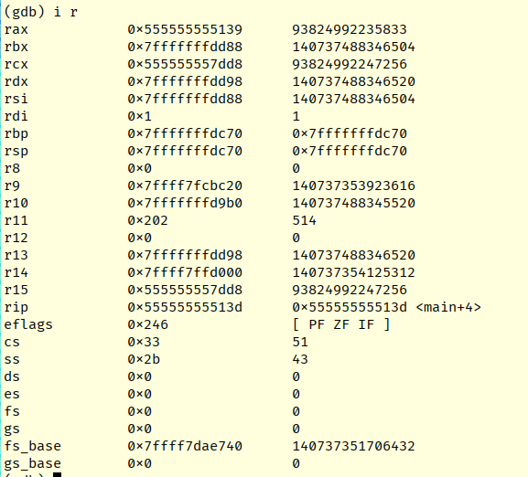
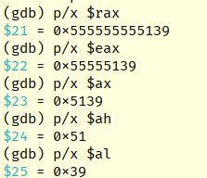
Registers
Represent internal state of the processor, fundamental to understand.
We are in 64-bit architecture; hence all registers are 8-byte long
It is possible to use only a subset of available space in each register
Example:
RAX – 8 bytes
EAX – 4 bytes
AX – 2 bytes
AH – higher byte of AX
AL – lower byte of AX

Slide 15
Registers – ones to care about
Like in life, some are more privileged than the others:
RIP – Instruction Pointer.
Points to the next instruction that will be executed. Easily the most important register out there.
RAX – Accumulator
Most frequently used data register. Used for returning data from function calls and to request particular syscall number.
RSP – Stack Pointer
Points to where top of the stack is currently. Extremely important for exploitation and ensuring program works correctly. More on stack later.
RBP – Base Pointer
Less useful than RSP, still important. Used to track base of a stack frame. More on stack later.
RDI, RSI, RDX, RCX, R8, R9
In that particular order. These are used to pass arguments to function calls (Linux convention!)
All other registers are general-purpose. There are some conventions (like RCX being mainly used for maths), but they have absolutely no extra meaning from our perspective.

Slide 16
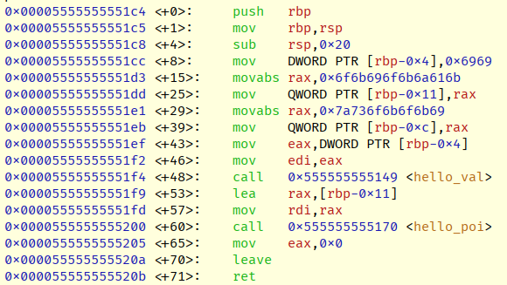
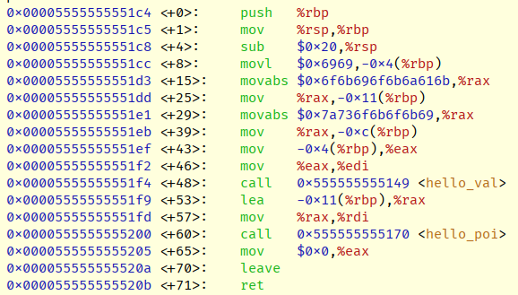
Instructions
Instruction consists of an opcode and arguments depending on the opcode used
Most of the instructions can take arguments of different type or size
Processor executes one instruction at a time
x64 has variable instruction length – meaning that different instructions have different lengths.
This leads to interesting behaviors. For instance, instruction will be interpreted differently if executed from the middle of its’ constituent raw bytes
ARM is different, they have fixed-length instruction size.
There are two major syntax flavors – AT&T and Intel. We are going to use Intel’s throughout the course.
<- Intel
AT&T->

Slide 17
Instructions - basics
Instructions with arguments follow the general structure of:
OPCODE <DESTINATION>, <SOURCE>
Arguments to the instructions can be of three types:
Immediate values –a raw value that will be processed
Registers – name of the register, whose value is to be used
Pointer – a value or register containing address pointing to the actual value

Slide 18
Instructions - examples
Moving immediate value into RAX
MOV RAX, 0x4041424344454647
Adding RDX to RAX and storing result in RAX.
ADD RAX, RDX
Doubling the value of AX. Remember, AX is much smaller than RAX (2 bytes long).
ADD AX, AX
Moving value stored at address pointed to by RAX into RAX
MOV RAX, [RAX]
=?=
MOV RAX, QWORD PTR [RAX]
Notes:
Last two examples are equal. In this case there is no ambiguity in the argument size.
Ambiguous examples
mov [rax], 1
inc [rax]

Slide 19
A word on words
The last example might feel confusing without additional explanation:
MOV RAX, QWORD PTR [RAX]
QWORD PTR [RAX] -> take a value pointed at by RAX and interpret it as a quad WORD pointer (address to data that is 8 bytes long).
Words are just a way of specifying size of data in computing. In x86/x64 ISA, the values are as follows:
BYTE – 8 bits
WORD – 16 bits
DWORD (double WORD) – 32 bits
QWORD (quad WORD) – 64 bits
Circling back to our example, it means that value pointed at by RAX is 8 bytes long :]
Notes:
WORD being 16 bits is a legacy from 8086 times

Slide 20
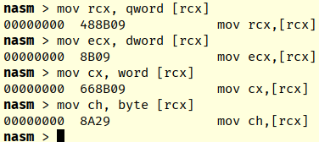
A word on words
Word sizes directly map to registry sizes, using RCX as an example:
BYTE – CL or CH
WORD – CX
DWORD – ECX
QWORD - RCX

Slide 21
Fundamental Instructions - MOV
MOVes (actually copies) the value from the SRC to the DST
MOV DST, SRC
MOV accepts all three types of arguments – immediate, registers and pointers
Examples:
MOV RAX, 0x10
MOV RDI, RAX
MOV RAX, [RBX]

Slide 22
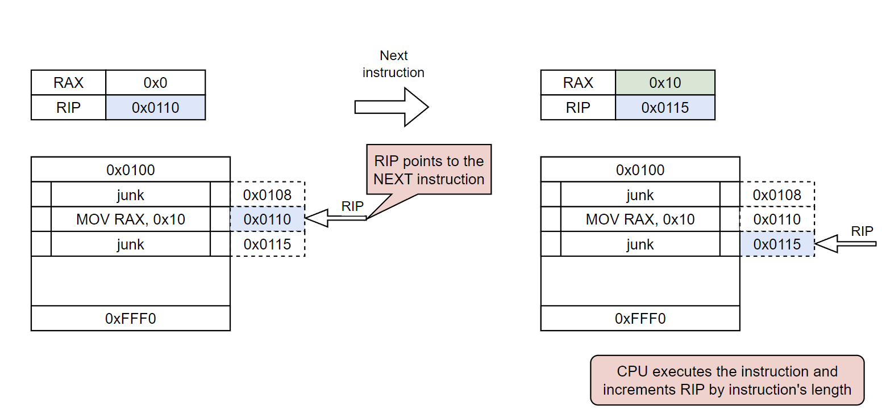
Fundamental Instructions - MOV
Immediate value example

Slide 23
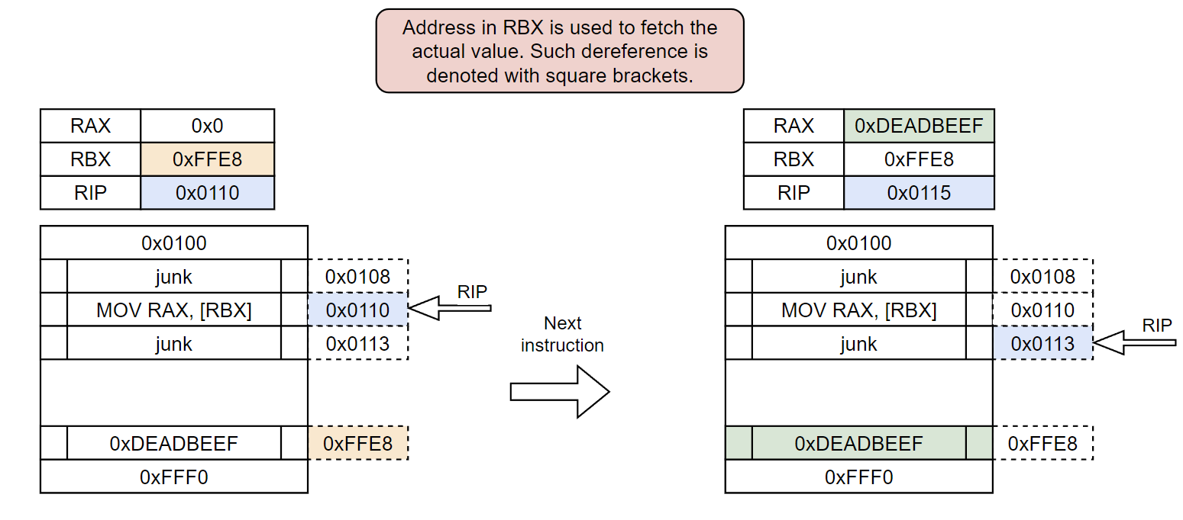
Fundamental Instructions - MOV
Pointer example

Slide 24
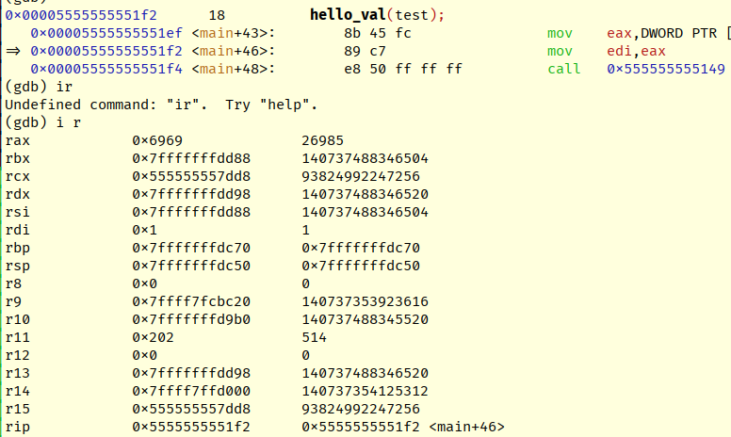
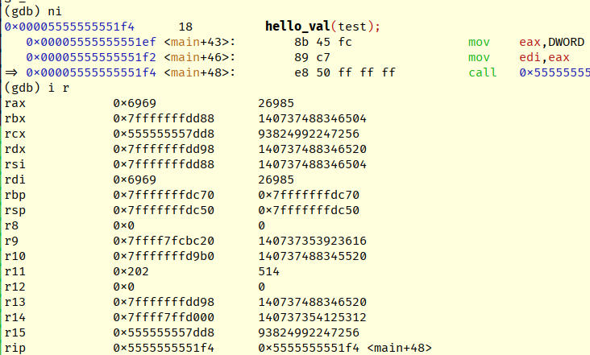
Fundamental Instructions - MOV
Register example from actual debugger
->

Slide 25
Fundamental Instructions - LEA
Load Effective Address – used to perform pointers arithmetic and storing results in the DST
LEA DST, [SRC +/- SRC2*x +/- y]
LEA calculates the result of whatever’s in square brackets and store is into DST. It makes calculation much easier by eliminating the need to use intermediate registers.
Examples:
LEA RAX, [RBP - 32]
LEA RAX, [RDI + RSI*4]
Notes:
Its also implemented in HW making it blazing fast and does not modify processor flags, allowing to perform maths without clobbering other calculations.

Slide 26
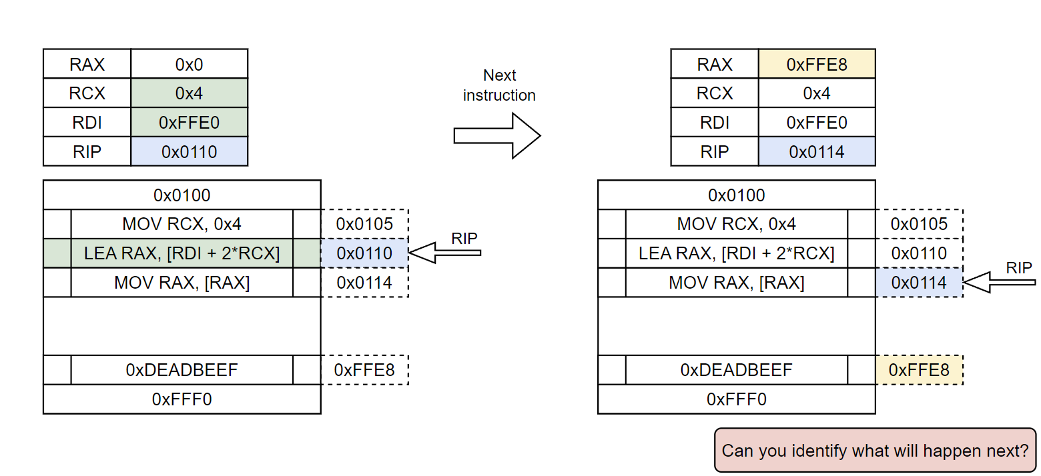
Fundamental Instructions – LEA

Slide 27
Fundamental Instructions continued
Other important instructions to know:
ADD/SUB DST, SRC
adds/subtracts SRC to/from DST and stores the result in DST
INC/DEC DST
INCrement/DECrement DST by 1
XCHG DST, SRC
eXCHanGe values between DST and SRC
PUSH/POP
put/take data from the stack. We will talk about stack after 1st lab
CALL/RET
call/return from function. We will talk about that when covering stack

Slide 28
Note on endianness
In my experience, one of the most confusing things when coming into low-level exploitation for the first time. Getting it right at the beginning goes a long way.
A big-endian system stores the most significant byte of a word at the smallest memory address and the least significant byte at the largest. A little-endian system, in contrast, stores the least-significant byte at the smallest address.
Of the two, big-endian is thus closer to the way the digits of numbers are written left-to-right in English, comparing digits to bytes.
~Wikipedia

Slide 29
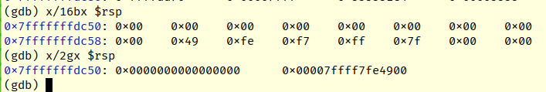
Note on endianness
We, humans, intuitively use big-endian (BE) notation. x86/x64 and many others use little-endian (LE).
Endianness is important ONLY when it comes down to numbers. However, when inspecting other data types debuggers will also interpret it as number unless specified otherwise. This leads to confusion
Numbers are stored “pairwise-reversed” – LE
Debuggers by default convert data to BE
This is best seen when displaying single bytes vs quad words
Just be mindful of this fact when displaying data as numbers
Converting between endiannesses:
0xFFEEDDCC
0xCCDDEEFF
Same piece of data interpreted as single bytes and quad words:

Slide 30
LAB 1
30 minutes
Observing assembly in GDB
Instruction:
handout/lab1.pdf

Slide 31
Stack
One of two structures representing program’s dynamic memory (other is heap)
LIFO queue – Last-In-First-Out
Values are managed by PUSHing them on top of the stack or POPping them from the top
All elements are 8-byte chunks!
Keeps track of all function calls, stores local variables and ensures program “knows” where to return from a function.
Starts at the end of the program’s address space and grows upwards (towards lower addresses)
This is can get a little confusing without diagrams…

Slide 32
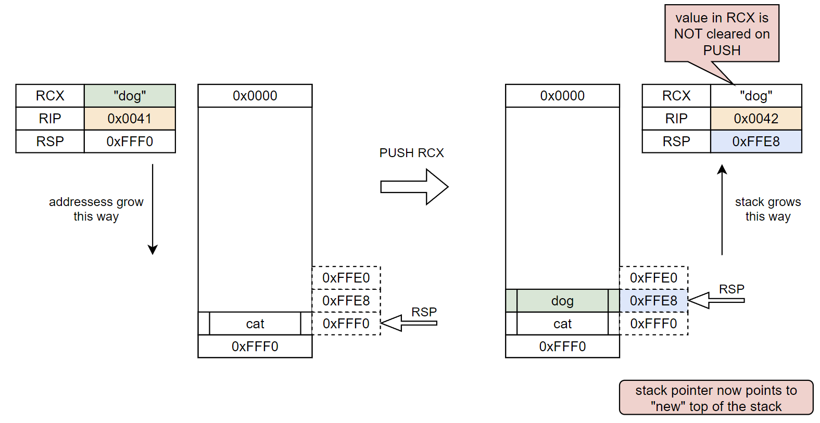
Stack - PUSHing

Slide 33
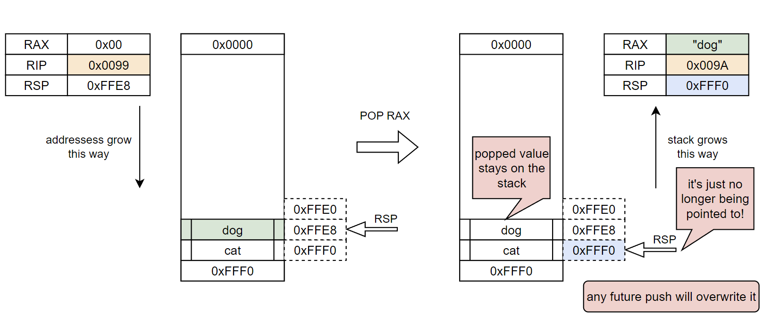
Stack - POPing

Slide 34
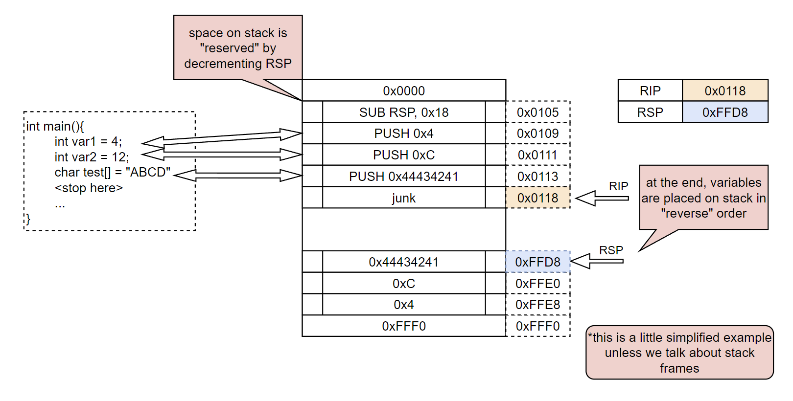
Stack – local variables

Slide 35
Stack – important considerations
Stack is where RSP tells it to – in other words, there is absolutely nothing preventing programmer from “moving” stack to any other writable memory region by overwriting RSP.
Will it break the program? Most of the time, yes. However, this can be utilized offensively, e.g. with Stack Pivoting technique, which is used to move stack to other memory we have control of.
While stack grows “downwards” (towards lower addresses), any kind of data access is done by incrementing memory addresses.
In some cases this allows attacker to overwrite previously pushed values, leading to memory corruption.

Slide 36
Stack Frames
A final chapter of assembly primer!
Stack frames are a way for programs to maintain state between function calls. These are just contiguous stack regions, with boundaries tracked through two registers – RBP and RSP
RBP – Base Pointer, tracks the base of current stack frame
RSP – Stack Pointer, we know it already. Tracks the top of the frame (and top of the stack at the same time).
On every function invocation (CALL instruction) a stack frame is created, this creates virtual separation between local and other variables.
Every function call is an act of redirecting execution; stack frames retain instruction pointer to the instruction following the original CALL, allowing execution to return correctly after handling function’s code.
On every return (RET instruction) the previous stack boundaries are restored, effectively “destroying” previous frame.
In practice, the old data remains on stack. It will be overwritten soon but there is no built-in mechanism of clearing it.

Slide 37
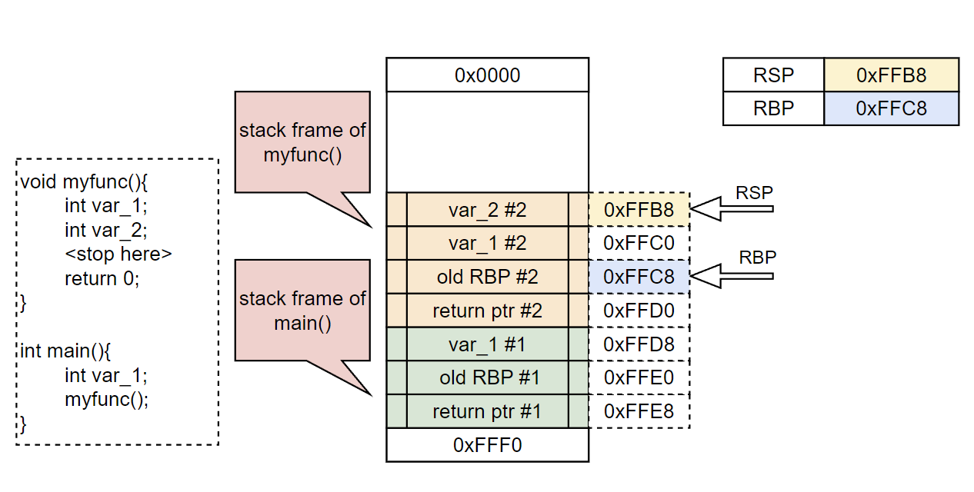
Stack Frames

Slide 38
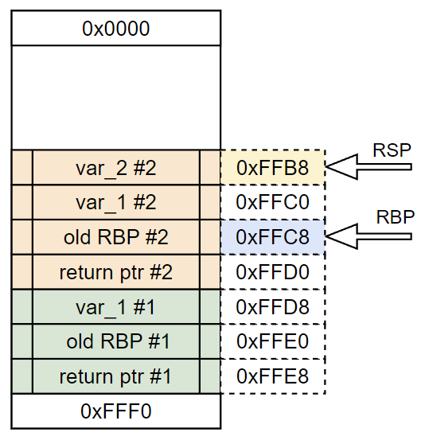
Stack Frame lifecycle
CALL instruction is executed, pointing to a target function
current RIP is pushed onto stack, forming a return pointer
Execution is transferred to the address pointed by call
New function set ups its’ stack frame:
current RBP is pushed onto stack
current RSP is moved to RBP
this establishes base of the frame, pointing at old RBP
function reserves space on stack for variables by SUBtracting from RSP
Function runs through
On function end
RBP is MOVed to RSP, “collapsing” stack back to point at old RBP
RBP is POPped from the stack
return pointer is popped from stack into RIP by issuing RET instruction

Slide 39
Stack Frame lifecycle
These patterns are so common, they have their respective names.
Learning to recognize them is the first step towards efficient skimming through assembly.
CALL instruction is executed, pointing to a target function
current RIP is pushed onto stack, forming a return pointer
Execution is transferred to the address pointed by call
New function set ups its’ stack frame:
current RBP is pushed onto stack
current RSP is moved to RBP
this establishes base of the frame, pointing at old RBP
function reserves space on stack for variables by SUBtracting from RSP
Function runs through
On function end
RBP is MOVed to RSP, “collapsing” stack back to point at old RBP
RBP is POPped from the stack
return pointer is popped from stack into RIP by issuing RET instruction
Function Prologue
Function Epilogue

Slide 40
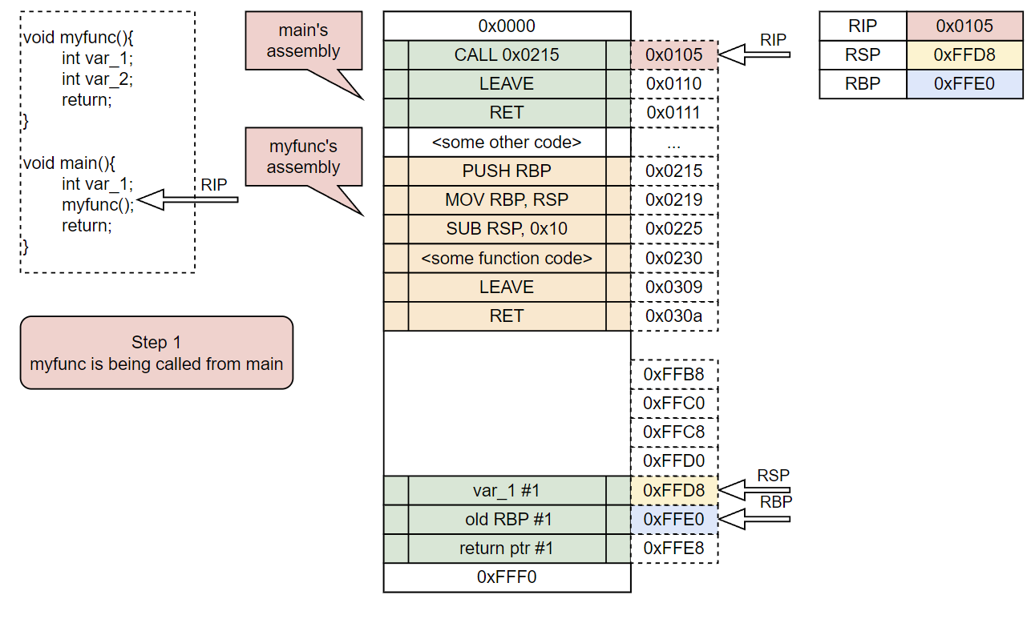
Stack Frame lifecycle example

Slide 41
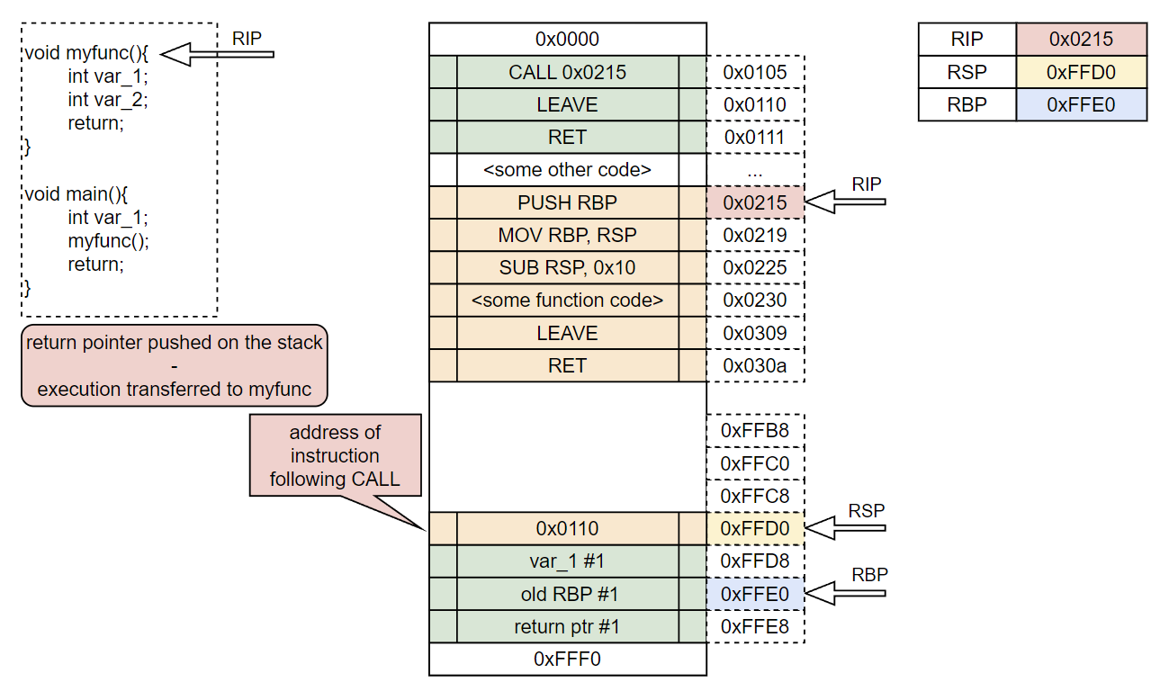
Stack Frame lifecycle example

Slide 42
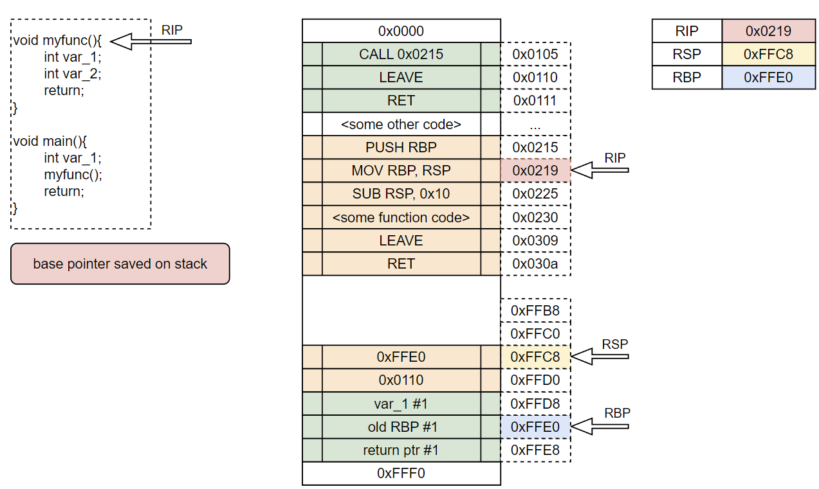
Stack Frame lifecycle example

Slide 43
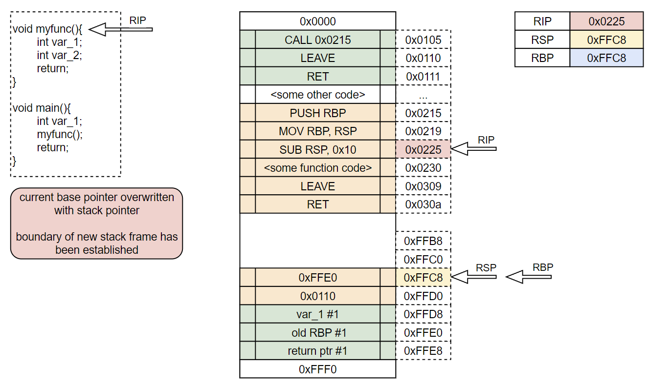
Stack Frame lifecycle example

Slide 44
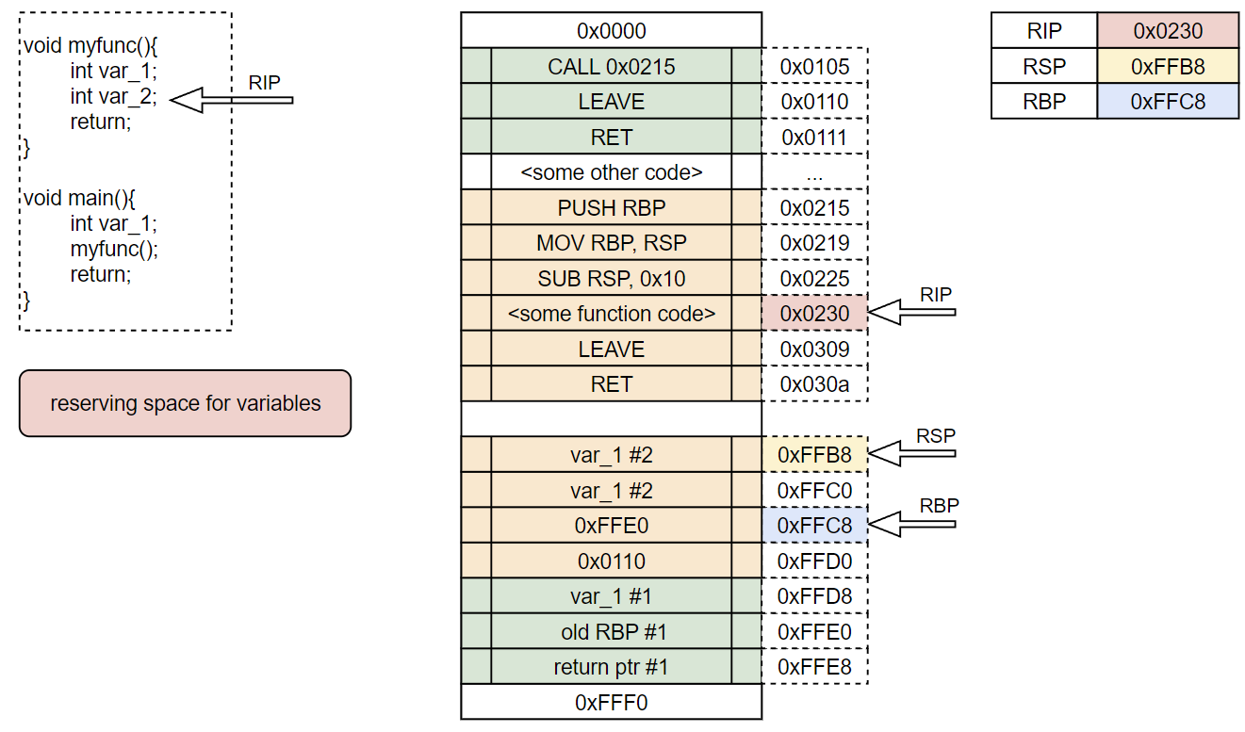
Stack Frame lifecycle example

Slide 45
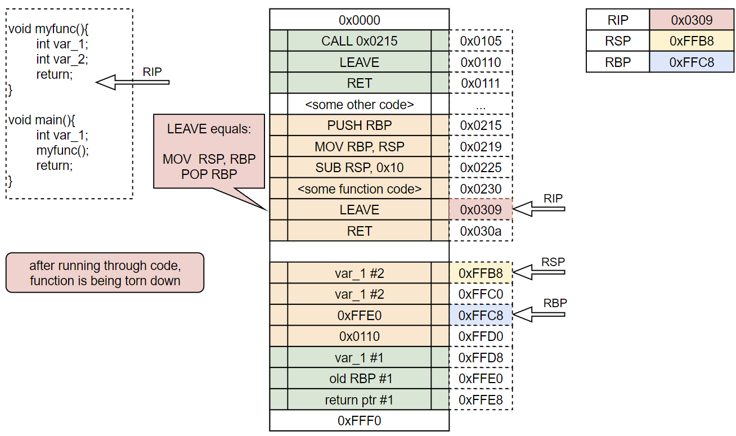
Stack Frame lifecycle example

Slide 46
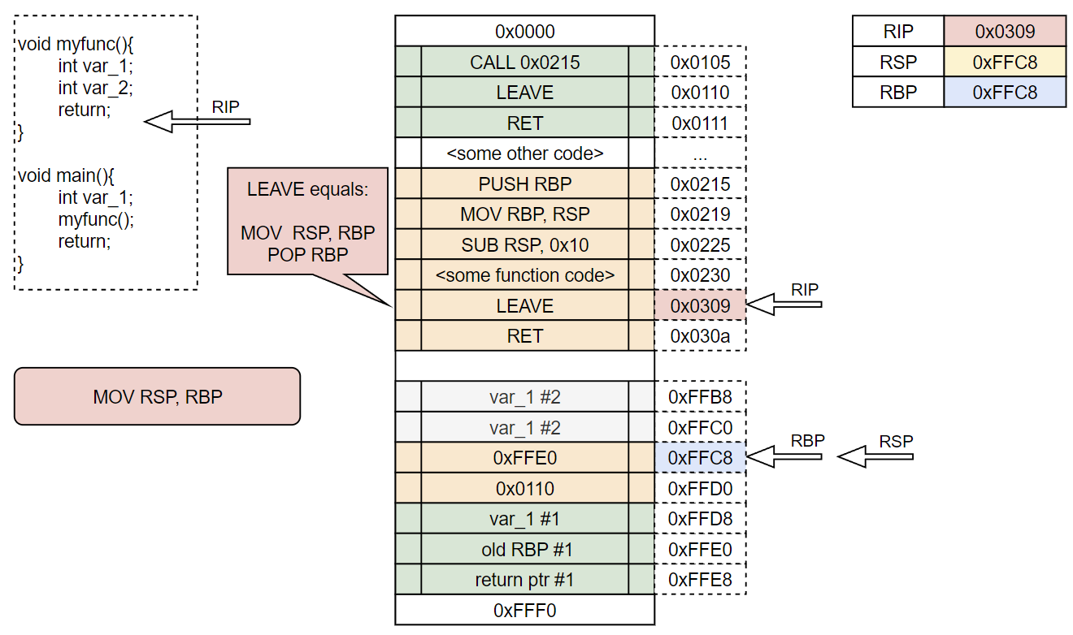
Stack Frame lifecycle example

Slide 47
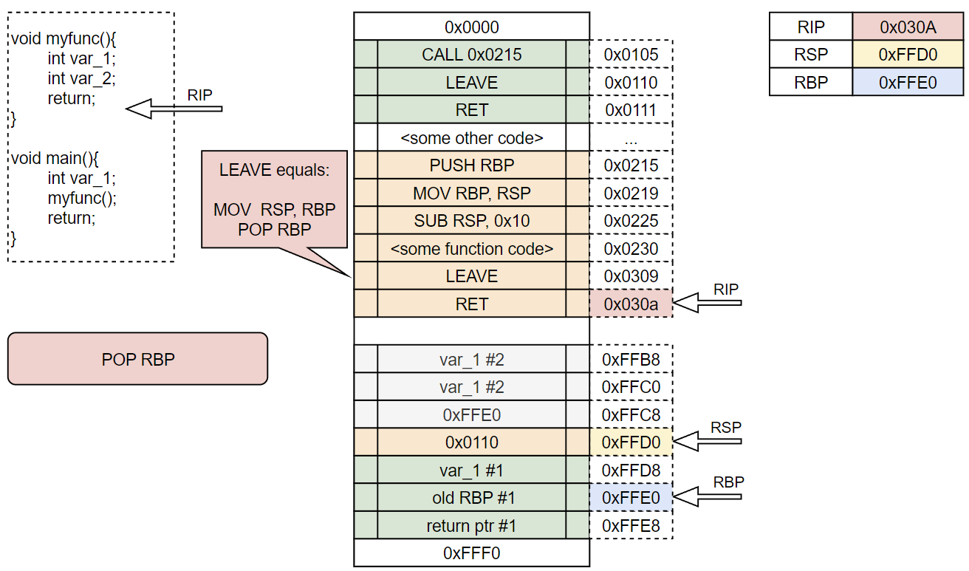
Stack Frame lifecycle example

Slide 48
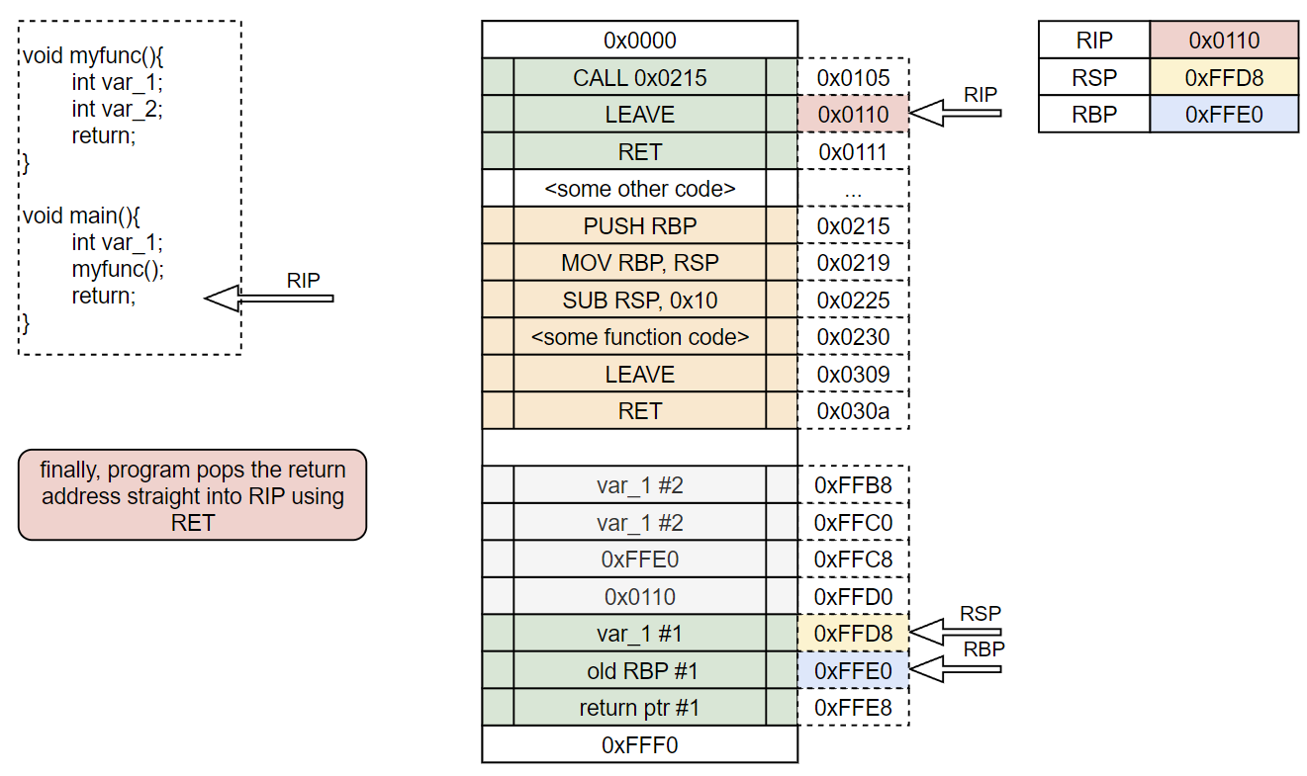
Stack Frame lifecycle example

Slide 49
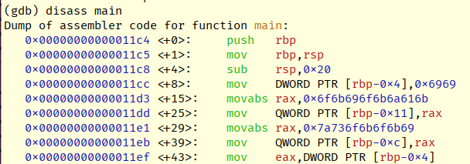
Purpose of Base Pointer (RBP)
Up until now we’ve talked about RBP being used only to delimit frames
By being stable point of reference, it is also used to access local variables on stack
Recall that stack can be allocated only in multiplies of 8 while some data types can be shorter or longer.
By MOVing memory on allocated stack space instead of pushing it, programs have more flexibility with memory management
e.g. storing two ints (2 x 4bytes) in one 8-byte stack segment is impossible through PUSHes alone
example of addressing local variable through RBP
MOV [ RBP - 0x8 ], RDI

Slide 50
LAB 2
30 minutes
Observing assembly in GDB p.2
Instruction:
handout/lab2.pdf

Slide 51
Buffer overflows

Slide 52
Buffer overflows
a very classic vulnerability, which spawned entire field of memory corruption bugs and remains potent to this day
occurs when too much data is copied to a buffer, most of the times due to lack of input bounds checking or wrong API usage
when overflow occurs, memory following the initial buffer gets corrupted with input data
as we’ve observed in previous chapter local variables and saved pointers coexist in the same stack frames. Thanks to that we can:
overwrite some other variable on stack and abuse program’s logic
overwrite return pointer to take control over what is being executed
just smash all the way down through the stack until we find something useful

Slide 53
Stack smashing
Most of the time we will want to overflow buffer so that we can take control of saved return address. When RETurning from function, this value will be placed in RIP, effectively allowing us to take control of the program.
Few techniques here:
ret2win – CTF classic, return to some function unavailable through the normal code flow which results in system shell or yields flag. One can think of it as returning to administrative or privileged function in normal software.
ret2shellcode* – we inject data that can be interpreted as valid instructions somewhere in the program’s memory and then point the RIP to its beginning
Remember?
Everything is data!
*this won’t work with modern mitigations enabled, we do need to begin somewhere though

Slide 54
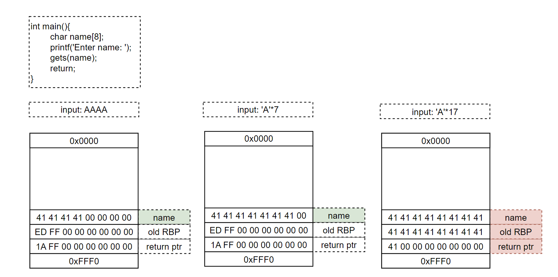
Stack smashing – overflow example

Slide 55
LAB 3
40 minutes
Exploiting buffer overflows with no mitigations enabled
Instruction:
handout/lab3.pdf

Slide 56
SHELLCODING primer

Slide 57
Shellcode
Shellcode is just a machine code ready to be executed on processor
Since it translates directly to assembly, we can leverage our knowledge to understand or build one
Shellcoding is an art in itself and its’ tricks are definitely beyond scope of our workshop
However, I want to lay some groundwork that will allow you to continue diving deeper in these concepts later without feeling overwhelmed.
Writing assembly is really important to learn, we WILL need that understanding for building ROP chains
There is also much added value in the fact, that writing shellcode makes understanding assembly so much easier through practice

Slide 58
Shellcode
During the labs we’ll be using Keystone Engine, a multi-architecture assembler framework
There’s a bit of boilerplate involved, relevant templates will be provided so we don’t waste time learning the framework’s overhead now.
The important takeaway is this – we will focus on writing plain assembly, framework will convert it to machine code for us, which we can use in our exploits later.

Slide 59
OS considerations
How does a processor really work with an operating system – each is so different, there seems to be a disconnection between the OS and assembly itself
Answer to this question has been an a-ha moment for me, everything just clicked from there.
When programming in a higher-level language we just take it for granted – import some library and call functions that are provided there.
But these libraries and functions at some point have to actually execute some code interacting with the OS. How do they do that?
Enter, syscalls

Slide 60
Syscalls
Syscalls or system calls are a suite of primitive instructions defined by the OS itself that can be called through assembly
Again, these are dictated by the OS only, therefore each OS will have its’ own syscall set and convention
In general, invoking a system call is performed by filling relevant registers with arguments that will be passed to the OS and executing a SYSCALL opcode.
Again, registers and syscall numbers differ between systems, luckily Linux’s system calls are well documented and understood. Their numbers are fixed and known
On the contrary, Windows’ syscall are a major pain to work with, their numbers may or may not change between builds, documentation is scarce and every behaviour is subject to change at any given moment. Truly a disaster (it is fascinating though).

Slide 61
Linux syscalls
Recipe for Linux is very simple
Fill RAX with syscall number we want to call
during this workshop we’ll use execve() exclusively, its’ number is 0x3B
Fill any other registers as required by documentation
Execute SYSCALL instruction
Result will be returned through RAX
https://filippo.io/linux-syscall-table/

Slide 62
Linux calling convention
This is a perfect moment to touch on Linux’s calling convention
Have you ever wondered how are arguments passed to the functions? This is defined by calling convention*
In particular it goes like this:
RDI – 1st arg
RSI – 2nd arg
RDX – 3rd arg (and so on)
RCX
R8
R9
Any other arguments go on stack
*calling convention also specifies other things such as callee- and caller-saved registers. We intentionally skip over that as it does not add any substance for our current purposes

Slide 63
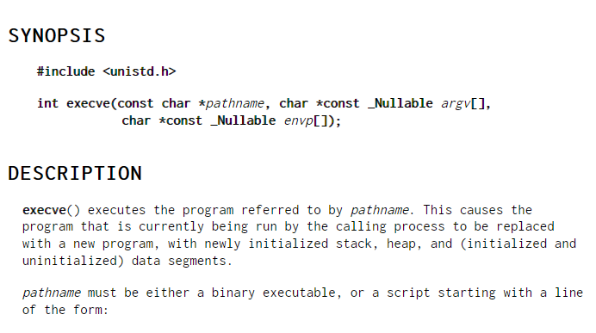
Calling execve
To finally tie all these concepts together, consider the following excerpt from manual of execve:

Slide 64
Calling execve
It can be summed as: “start a program given in *pathname argument”
To keep things manageable, lets consider starting a local shell
To achieve that we want to set:
1st argument: a pointer pointing towards address where “/bin/sh” string is present
Conventionally, C-style strings are null-delimited. That means, 0x00 byte is the last character of every string. Very conveniently, “/bin/sh\x00” is exactly 8-bytes long.
2nd argument: 0x00
3rd argument: 0x00
Why the zeroes? Well these arguments have to be provided but they also are nullable (as seen in docs)
argv would contain arguments for our program
envp would be the environmental variables passed to the program
these are useful, but safe to ignore if we just want to execute a specified binary as in our case

Slide 65
Writing our shellcode
Now that we’ve defined our needs, let’s convert them into required processor’s state to achieve that:
RAX – 0x3B
RDI – pointer to /bin/sh (1st arg)
RSI – 0x00 (2nd arg)
RDX – 0x00 (3rd arg)
and that’s about it

Slide 66
Writing our shellcode
Now that we’ve defined our needs, let’s convert them into required processor’s state to achieve that:
RAX – 0x3B
RDI – pointer to /bin/sh (1st arg)
RSI – 0x00 (2nd arg)
RDX – 0x00 (3rd arg)
and that’s about it
PUSH 0x3B
POP RAX
MOV RBX, 0x0068732f6e69622f
PUSH RBX
MOV RDI, RSP
XOR RSI, RSI
XOR RDX, RDX
SYSCALL

Slide 67
Writing our shellcode
While our shellcode should be mostly understood by now, this snippet calls for an explanation:
Remember the endianness discussion – we are pushing a “/bin/sh\x00” string in the form of a number. Therefore, we have to convert each character to its numeric value and input bytes-reversed
If you’d put it through some hex-to-string tool without specifying endianness, you’d see “\x00hs/nib/”
Second thing is – execve asks for an address of string
not a string itself
this is achieved by pushing string on the stack (which now points to it)
PUSH instruction does not support pushing immediate value bigger than 4 bytes. We have to use intermediate register
MOV RBX, 0x0068732f6e69622f
PUSH RBX
MOV RDI, RSP

Slide 68
Badchars
Often, programs will process some of the characters from our shellcode, effectively breaking it. Such characters are called bad characters, or badchars.
Most of the time nullbyte will be a badchar due to being string delimiter.
There are two tactics of bypassing badchars:
rewriting shellcode so that it does not contain them
encoding shellcode and using a dynamic decode routine during runtime (this is what payload encoders do)
In general, rewriting shorter shellcodes is feasible and relatively simple, the only thing needed is patience and creativity.
Encoders are a mile deep, explore them at your own peril
https://danielsauder.com/2015/08/26/an-analysis-of-shikata-ga-nai/

Slide 69
Brainstorming nullbyte evasion ideas
MOV RAX, 0 -> XOR RAX, RAX
MOV AX, 0x3B -> PUSH 0x3B ; POP RAX
MOV EAX, 0x002F2F2F - > MOV EAX, 0xFF1F2F2F ; INC EAX
MOV EAX, 0x002F2F2F - > MOV EAX, 0x012F2F2F ; DEC EAX
I highly recommend tinkering with msf-nasm_shell to debug what instructions have nullbytes

Slide 70
LAB 4
30 minutes
Generating own shellcode, nullbytes challenge
Instruction:
handout/lab4.pdf

Slide 71
Mitigations

Slide 72
Modern mitigations (Linux)
Prevalence of memory corruption bugs and their impact forced industry to invent some mitigations to make exploitation of such bugs much more difficult.
As we will see, they are at the same time highly effective and bypassable.
With all mitigations enabled, at the very least we are going to need two bugs to exploit the application
What we are going to cover
Stack canaries
NX/DEP
PIE/ASLR
For comparison, Windows offers (at least) the following mitigations: NX/DEP, ASLR/kASLR, CFG/kCFG, SMEP, ACG, CIG, CET, XFG, VBS, HVCI
Yup, that’s why starting your binexp adventure with Linux makes it a more streamlined experience ;]

Slide 73
Stack canaries
Very simple, yet powerful
Canaries are randomly generated values that are pushed in every stack frame on top of saved RBP
canary value is generated once per binary execution and stays the same across function calls. Its’ value is stored in qword [fs:0x28]
When RETurning from function calls, value on stack is checked against reference value
If there is no match (value is corrupted by overflow for example), program crashes
Two major ways of bypassing:
leaking cookie value either from stack or [fs:0x28] and aligning it correctly in overflow payload
precise overwrite bugs that do not affect the cookie

Slide 74
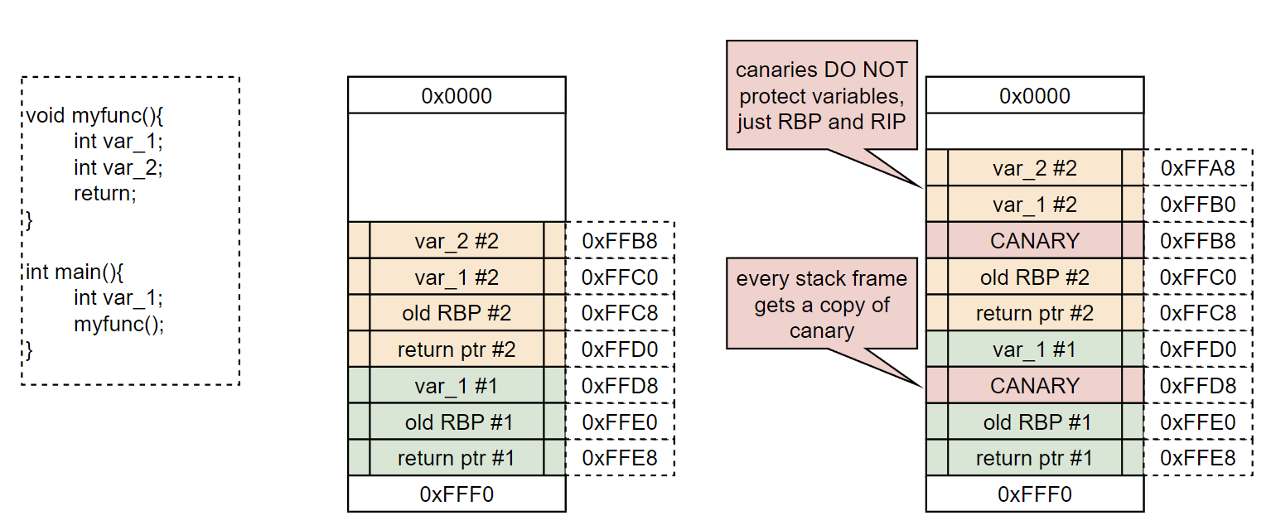
Stack canaries

Slide 75
LAB 5
60 minutes
Bypassing stack canaries
Instruction:
handout/lab5.pdf

Slide 76
NX/DEP
No-Execute or Data Execution Prevention are two names to describe the same security mechanism – make the memory regions that contain data non-executable
Most importantly, this affects stack
If execution is attempted from memory region marked as NX, program crashes
This effectively prohibits us from placing our own code in memory and returning to it
Bypassing this mitigation requires an entirely new school of thought, enter ROP – Return Oriented Programming

Slide 77
Sections and program memory
To continue further we have to briefly touch on two topics
Binary sections
How programs are mapped into memory
We will just scratch the surface here. There is quite a bit of depth in both topics that is way beyond scope of this workshop

Slide 78
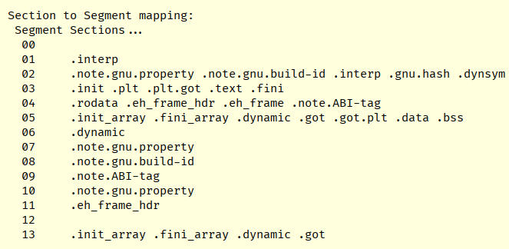
Binary sections
Compiled binaries are not just a blobs of code/data, there is underlying structure dependent on executable file format
Linux uses ELF, windows uses PE. Both are loosely based on COFF (trivia for curious minds)
Sections form the backbone of executables. These are named parts of file that contain specific types of data. Few examples:
.text – contains the actual code that gets executed
.rodata – read-only data, contains data that will not change throughout execution, for example static strings
.data – initialized global variables
.bss – uninitialized global variables
Exemplary dumped sections from ELF

Slide 79
Mapping programs to memory
Binary cannot be run in the void. It first has to be loaded in the memory, together with any libraries it depends on.
Every program gets its own virtual address space provided by OS.
This is what sections are used for - loader maps them in the memory of the program and assigns necessary permissions (r/w/x)
For example, .text section becomes a memory region with read/execute privileges.
Any necessary dependencies are mapped into the program’s address space too
Linux uses .so (shared object) library files, Windows users are probably familiar with its counterpart – DLLs
After loading binaries into memory, other vital regions are mapped (such as stack or heap)
Finally, code starts executing at entry point

Slide 80
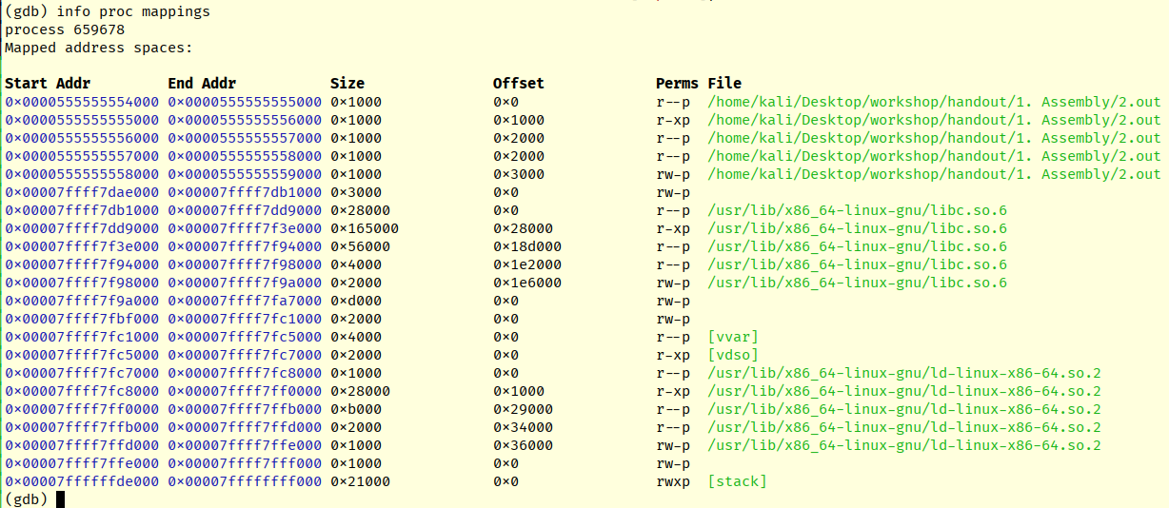
Mapping example
Here’s exemplary mapping with no NX enabled.
Notice stack’s permissions

Slide 81
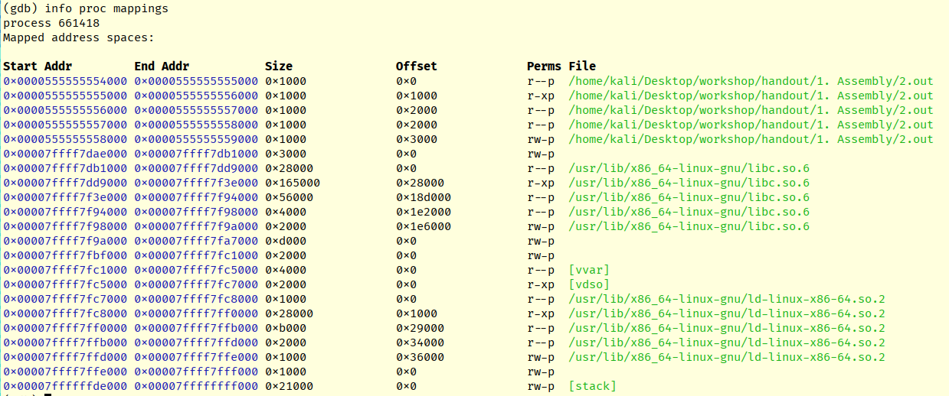
Mapping example
Here’s the same binary with NX enabled.
Notice stack’s permissions

Slide 82
ROP
Now that we know how NX/DEP is achieved (by removing executable memory permissions from data regions), lets introduce ROP
ROP or Return-Oriented Programming is a brilliant technique basing on the idea of code reuse.
By reusing code from the executables that are already mapped into memory (program’s binary and libraries) it is most of the time possible to craft a functional shellcode
To achieve this, exploit developer :
looks for assembly instruction chains (called gadgets) that end with RET in the target binary
drafts a functional shellcode using these instruction chains (called ROP chain)
places addresses pointing to gadgets on the stack, one after another
using memory corruption bug, overwrites RIP to point to the first gadget
program starts executing these small assembly instruction sets. Since each is ending with RET, they will pop address of next one from the stack and continue execution.
The important part is that stack is not containing code anymore, just pointers to pieces of legitimate code that are fetched through RETs into RIP. This does not violate NX/DEP since it’s not stack memory that is being executed. Through creative combining these pieces, malicious effect is achieved.
We are definitely in dire need of visuals for this one!

Slide 83
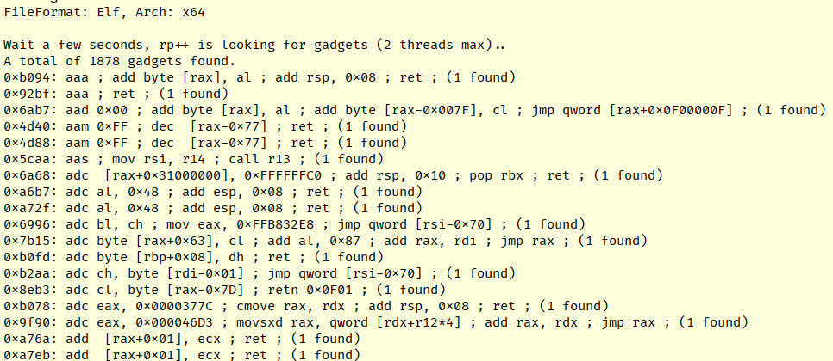
ROP
The following is how an exploit developer would look for instruction chains with rp++.
You can see offset in a binary where each chain begins and its constituent instructions. The idea is to combine such chains into something useful. Essentially, it’s puzzle-like shellcoding with constraints.

Slide 84
Libc ROP chain
Below is a draft of ROP chain I’ve prepared from the gadgets pulled from libc.
Imagine them being executed sequentially, it is essentially our shell-spawning shellcode from earlier chapter done with different instructions.
0x7d1b2: xor edx, edx ; mov eax, edx ; ret
0x3f80b: pop rax ; ret
0x3b – execve syscall no.
0x28bb2: pop rdi ; ret
<libc /bin/sh address*>
0xfc77e: xor esi, esi ; syscall
*what’s with the libc address? Turns out libc library contains hardcoded string “/bin/sh”, which is extremely useful for us as we can just point to its’ address in execve syscall.
btw – libc is always mapped into program’s memory if dynamically linked (default behaviour)

Slide 85
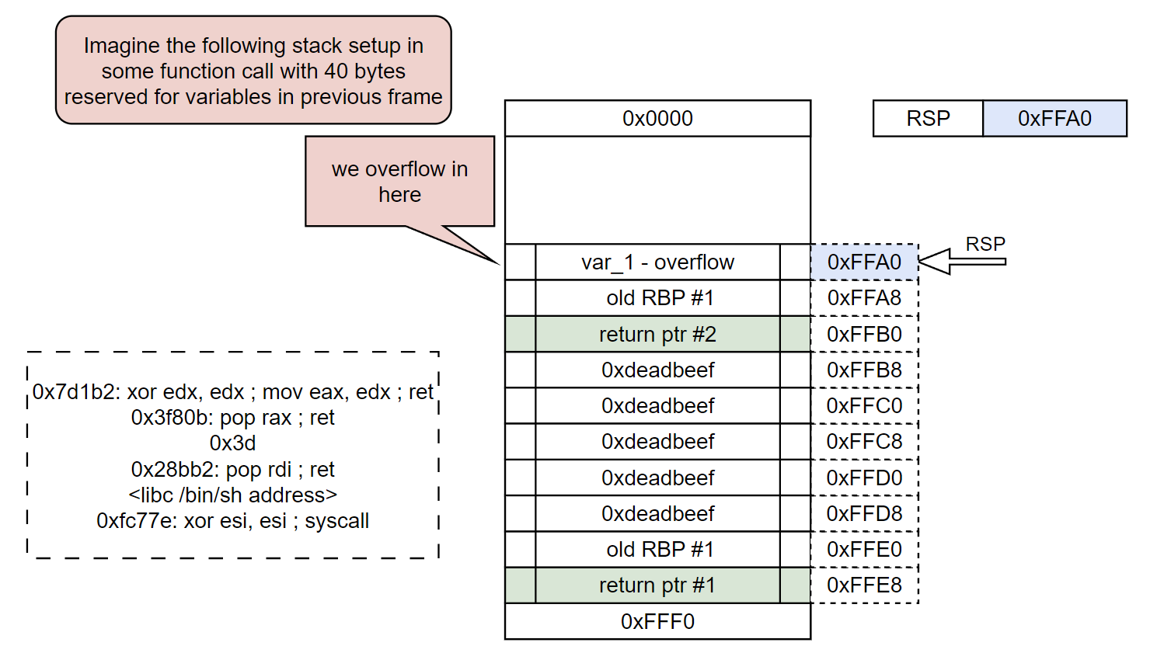
ROP visualized

Slide 86
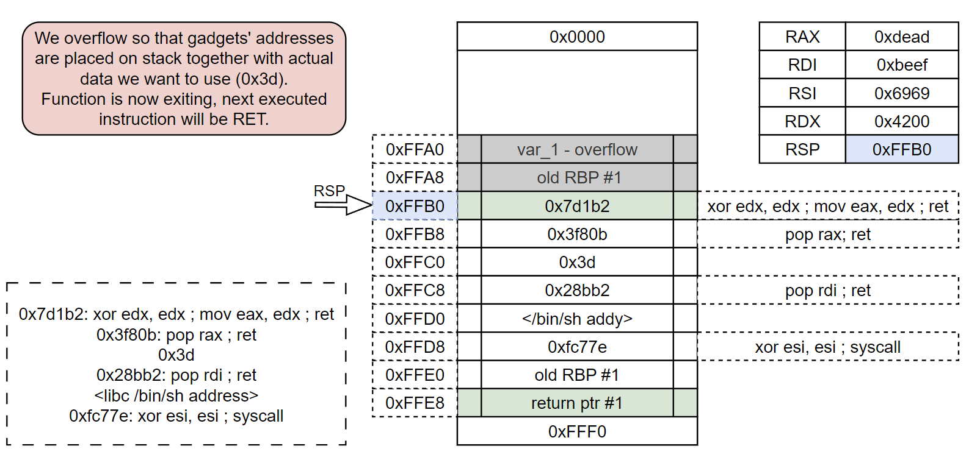
ROP visualized

Slide 87
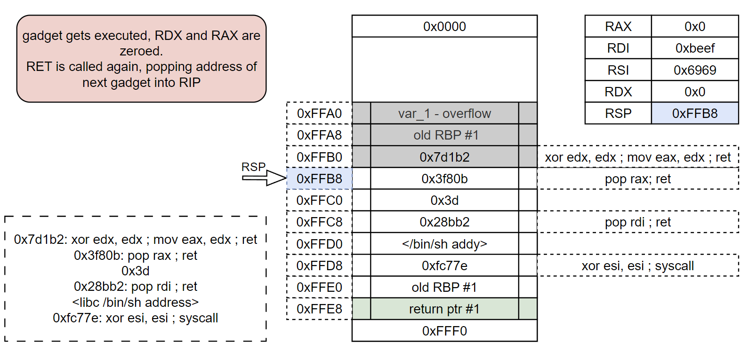
ROP visualized

Slide 88
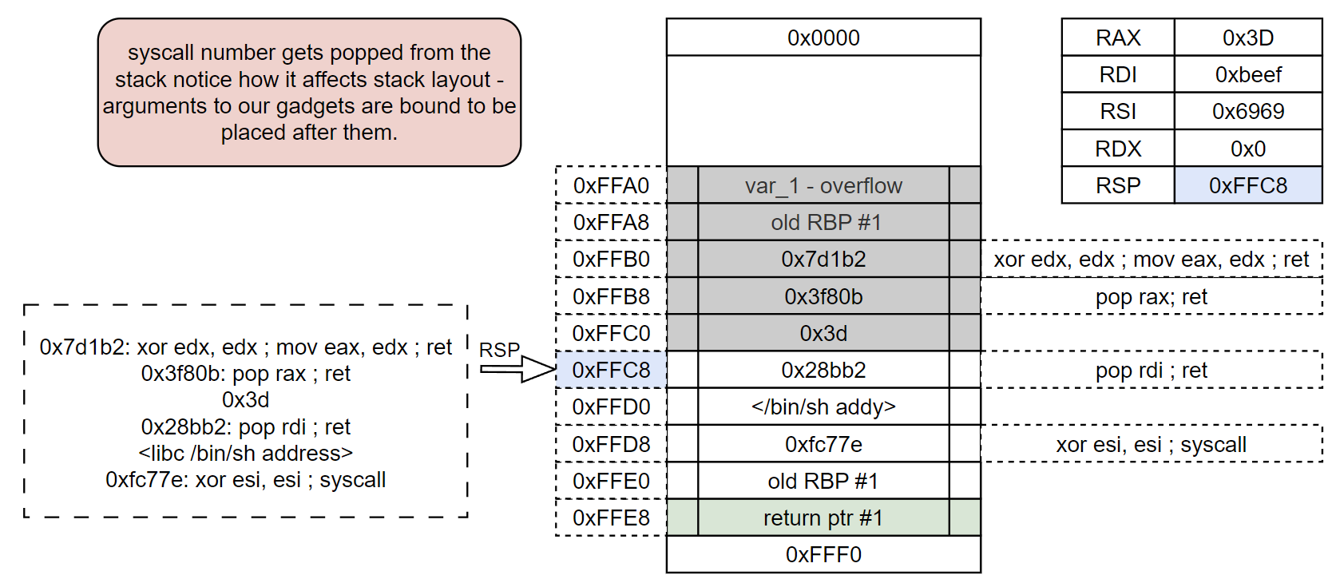
ROP visualized

Slide 89
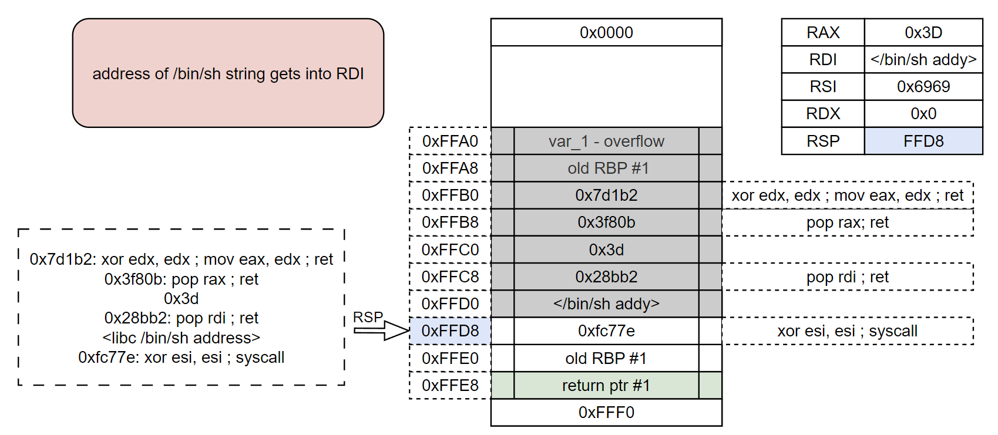
ROP visualized

Slide 90
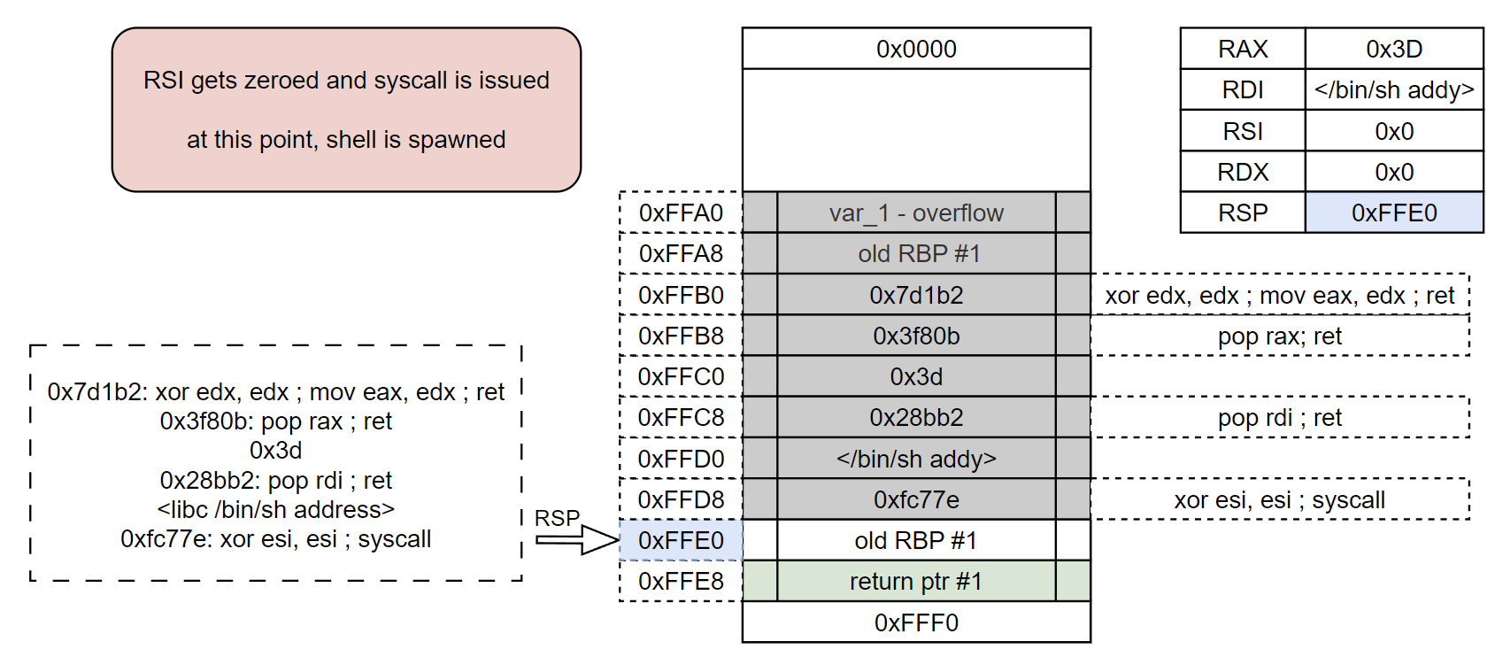
ROP visualized

Slide 91
LAB 6
40 minutes
Bypassing DEP with ROPs
Instruction:
handout/lab6.pdf

Slide 92
ASLR
Up to this point, all addresses we’ve used for exploitation were hardcoded – we knew them ahead of time, ASLR changes that.
ASLR or Address Space Layout Randomization is a mechanism of randomizing base addresses of all modules loaded into the program’s memory.
Addresses are randomized with every binary launch.
This seemingly minor change forces us to leak addresses from application during runtime. Effectively this requires us finding at least two bugs – infoleak and memory corruption
ASLR is enforced by kernel; not a compilation flag.

Slide 93
ASLR
To reiterate - ASLR is a mechanism of randomizing base addresses of all modules loaded into the program’s memory.
Despite being powerful, ASLR can’t just take any binary and shuffle its’ internal addresses around
Instead, it randomizes the base address only, that is, the start address of where the binary will be mapped into memory.
This means that all offsets, or “distances” between pieces of code inside binary remain the same
This process is applied separately for every library loaded into memory
To bypass ASLR, we essentially need to leak address of anything stored in the target binary. We can then calculate its’ offset from the base of binary and obtain the base address

Slide 94
ASLR bypass example
Assume we want to execute system() from libc.
We obtain its’ offset from base of libc.so.6; in this case it is equal to 0x53110
We find and utilize an infoleak in the app.
Let’s assume we’ve leaked an address of printf() from libc - 0x7ffff7e0a900
In the same manner as with system(), we obtain printf’s offset from libc base - 0x59900
Now we can calculate the base address, where libc has been mapped
libc_base = 0x7ffff7e0a900 - 0x59900 = 0x00007ffff7db1000
To obtain system()’s addy, all we need to do is to apply its’ offset to base:
system_addy = libc_base + 0x53110 = 0x7ffff7e04110
Finally, we plug this address into our payload and execute
That’s why automating our payloads goes a long way, we can do all that in few lines of code

Slide 95
PIE
One important consideration, albeit rarely existing today, is PIE
PIE stands for Position-Independent Executable
It’s a way how programs can be compiled and allows the code to be placed at artificial memory address and get executed
This mainly has to do with how historically a lot of addresses were hardcoded, forcing binaries to be mapped consistently (at the same base addresses) over time.
PIE requires everything work with offsets, no hardcoded pointers
A binary has to be compiled with PIE support to make ASLR work. It will break otherwise.
Almost everything is now compiled with PIE enabled, however if you ever find a binary without one, its’ addresses can be used for ASLR bypass.

Slide 96
How a leak can look like
struct user{
char username[32];
void (*printf_add)();
} g_user;
Leaks can be different and subtle but in general to leak a pointer you’d look to abuse some printing functionality and/or custom structures placed by the programmer
There is no blueprint for leaking things as these are always application-dependent
A good example would be a custom structure, containing a user-supplied input and some address, such as the one on the top of this slide
Remember that C-style strings are null-delimited and most of the printing functions will read UNTIL nullbyte
Imagine you were able to overwrite the username in the example struct with exactly 32 non-zero characters
What will happen if puts(username) is called?
We’ll explore this in the final lab

Slide 97
LAB 7
40 minutes
Bypassing ASLR
Instruction:
handout/lab7.pdf

Slide 98
Conclusion
It has been a long day, congratulations for going through
Are you confused, tired, overwhelmed? That’s perfectly right
This has been a LOAD of knowledge and if you have no familiarity with the topic, don’t expect to remember everything
The point is, if you want any of this to stick, you got to practice. There are some challenges to go through and I will probably add more over time.
Some of really great resources
https://www.corelan.be/index.php/articles/ - a classic with focus on Windows, most of the time outdated but the fundamentals do not change
https://wargames.ret2.systems/ - paid but oh-so-wonderful
https://guyinatuxedo.github.io/ - it has not worked for me but it just might for you
Books – some love them some hate them, I love a good technical book, especially a little older
Hacking – the art of exploitation
The Shellcoder’s Handbook
PoC || GTFO

